Slide 1
Unit Testing
Jason Monroe - 688776

Slide 2
Course Objective:
At the end this 60 min session, you will be able to
Write Unit Tests for a React App

Slide 3
Benefits
Must-know for React development
TDD

Slide 4
Key Topics
Testing Rendered Components
Testing Components Connected to Redux
Mocking and Spying
Testing Redux Actions

Slide 5
Testing Rendered Components

Slide 6
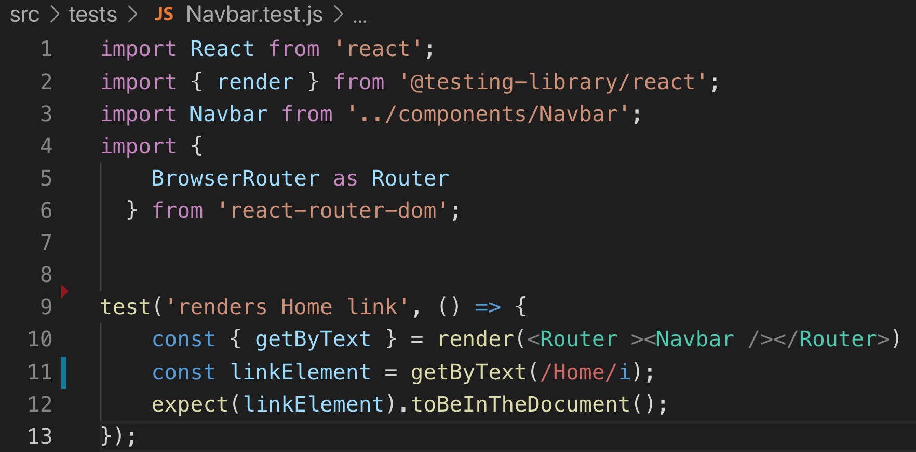
Exists in Document

Slide 7
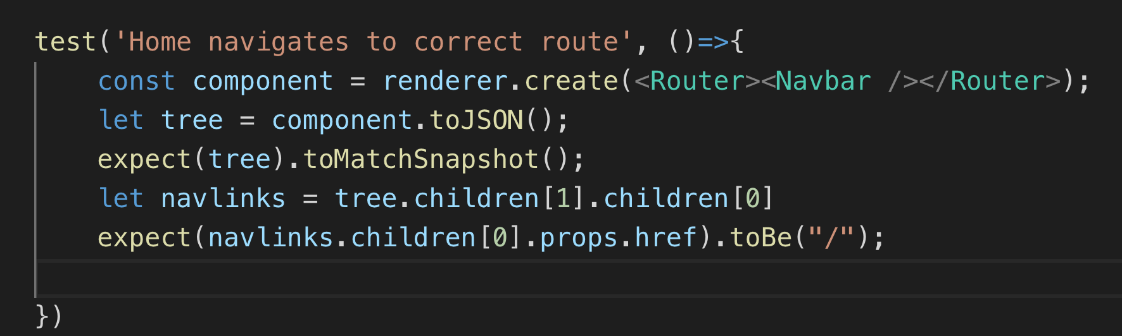
Navigates to Correct Route
https://jestjs.io/docs/en/tutorial-react

Slide 8
Testing Components Connected to Redux

Slide 9
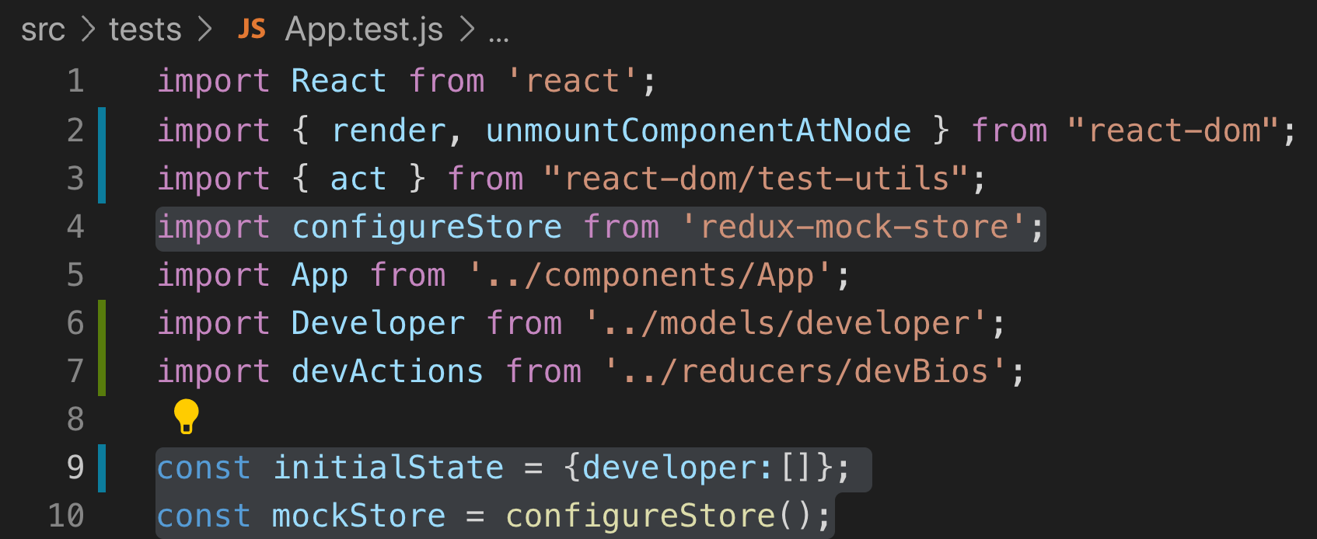
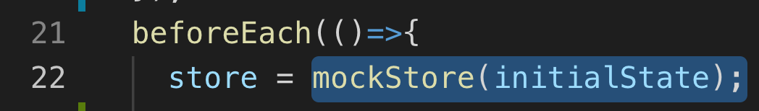
1. Set Up Mock Store
https://alligator.io/react/testing-redux-actions/
2. Pass to Component as store prop

Slide 10
Mocking, Spying on Functions

Slide 11
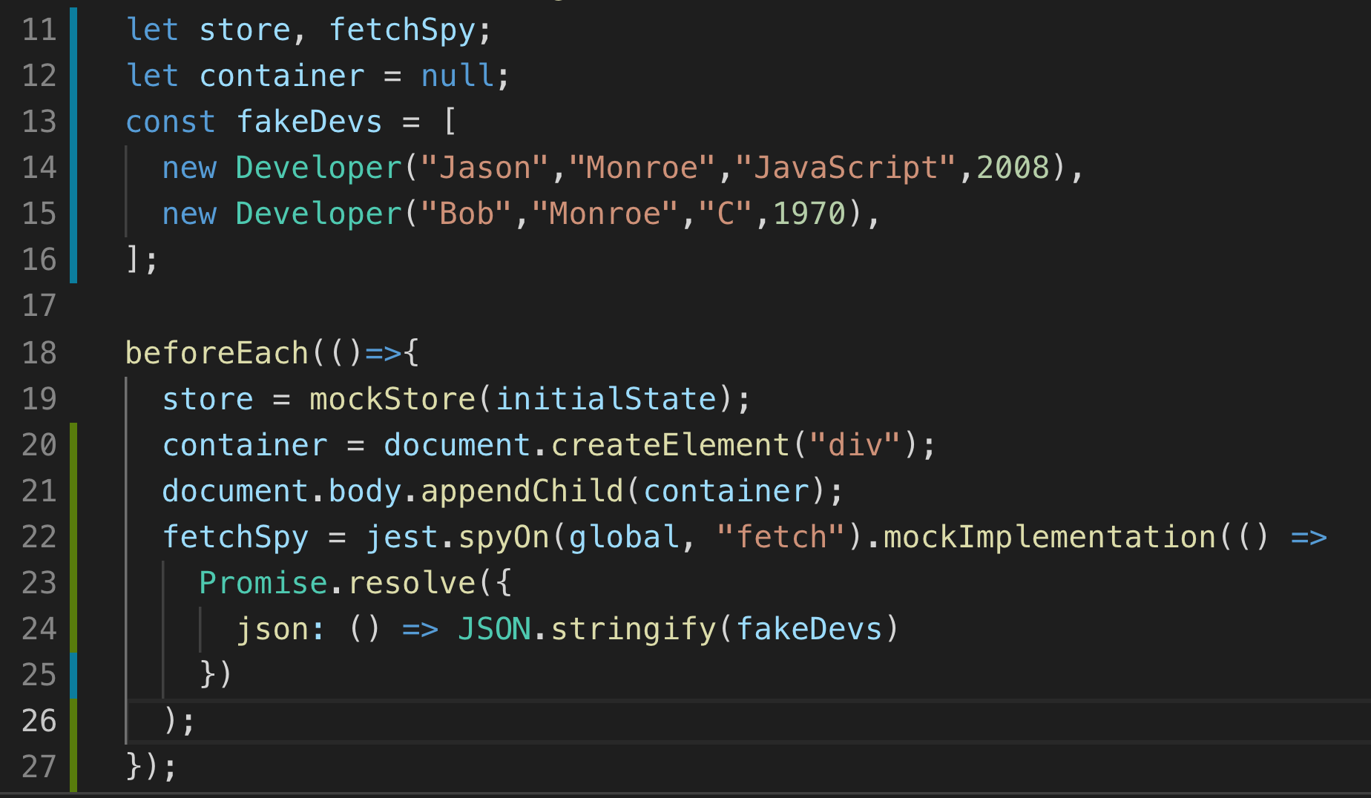
Jest.spyOn
https://reactjs.org/docs/testing-recipes.html

Slide 12
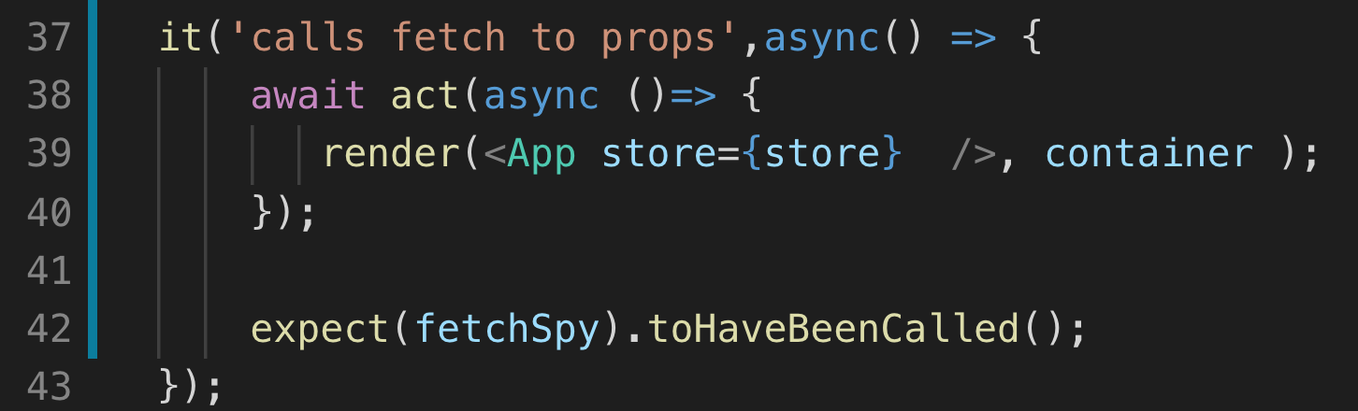
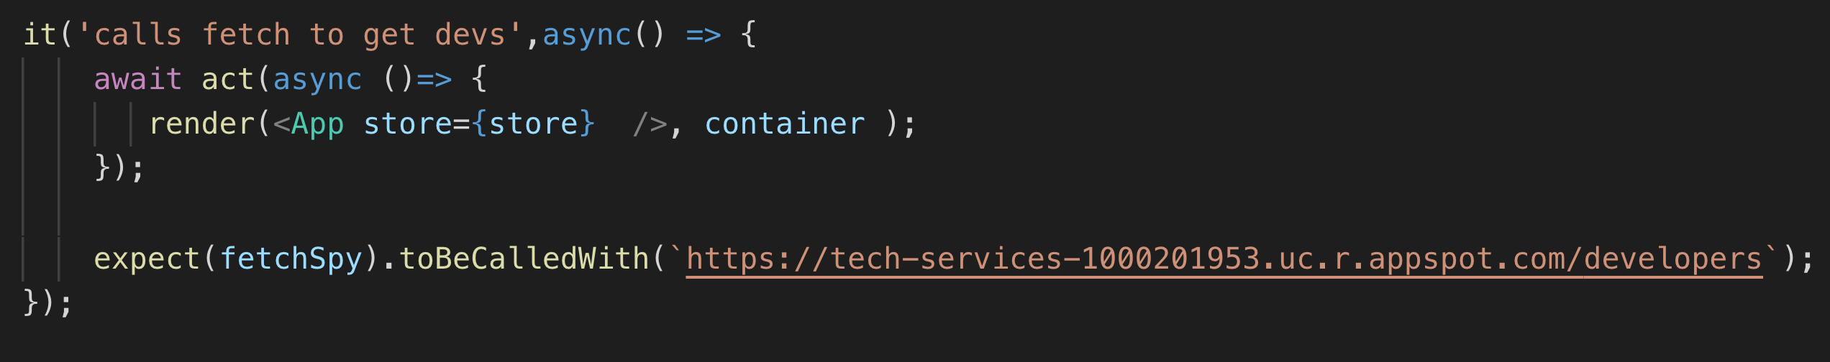
Expect function to be called or called with arguments

Slide 13
Testing Redux Action Creators

Slide 14
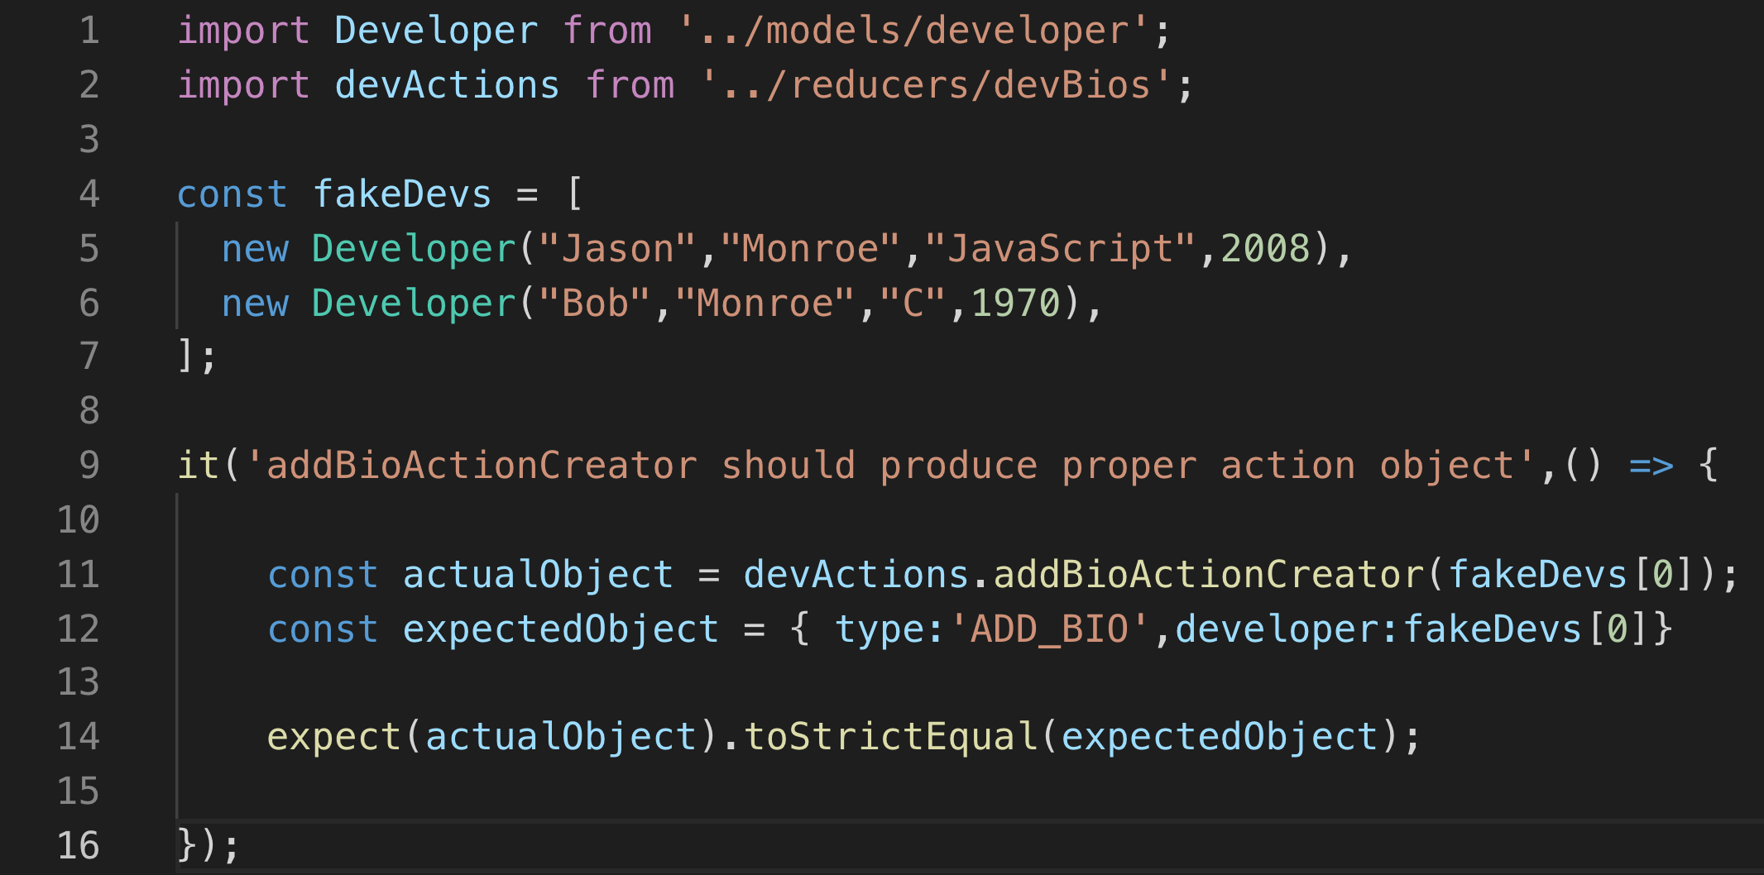
https://jsramblings.com/3-ways-to-test-mapstatetoprops-and-mapdispatchtoprops/

Slide 15
Testing Resource Appendix

Slide 16
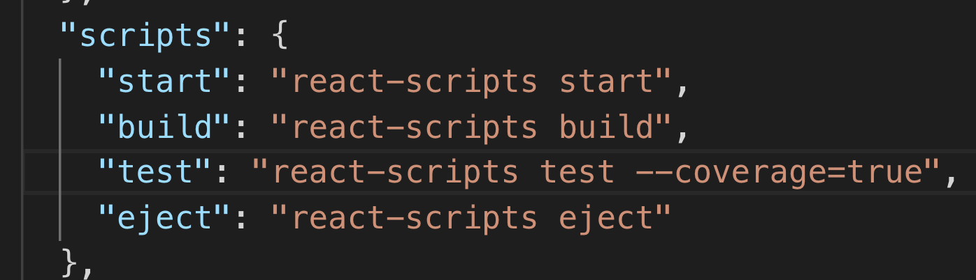
Show Code Coverage

Slide 17
Testing Basics
https://reactjs.org/docs/testing.html
https://medium.com/@rossbulat/testing-in-react-with-jest-and-enzyme-an-introduction-99ce047dfcf8

Slide 18
Alternative library Enzyme
https://testdriven.io/blog/tdd-with-react-jest-and-enzyme-part-one/

Slide 19
Testing Redux
https://jsramblings.com/3-ways-to-test-mapstatetoprops-and-mapdispatchtoprops/

Slide 20
Thank You Jason Monroe 688776

